Slide 1

DIGITAL STETHOSCOPE Circuit Check Presentation
Mehmet Fatih GÖĞÜŞ
Seha TÜN

Slide 2
Microphone Circuit
The parts of it:
* Two resistors, 10k ohm
* One capacitor, 1uF
* +12V input
* Ground

Slide 3
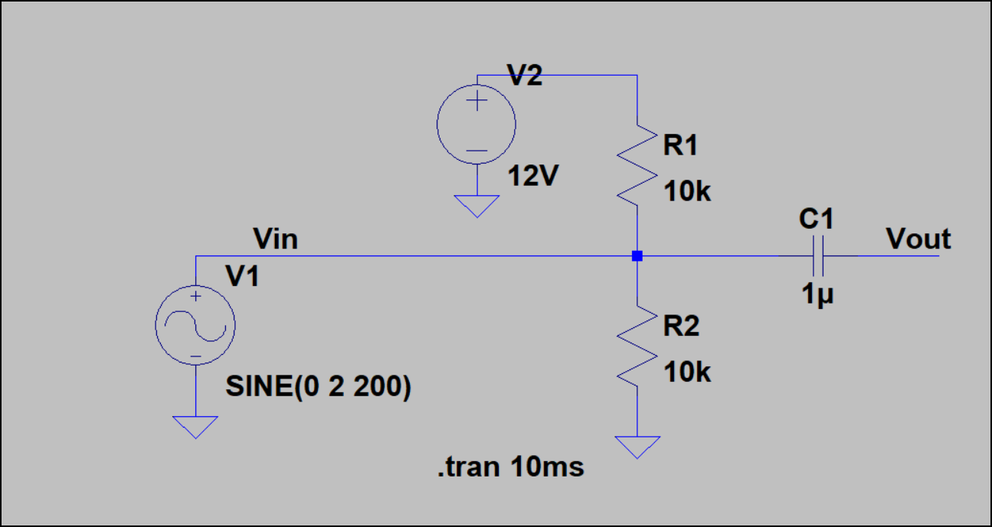
Microphone Circuit from LTspice

Slide 4
Amplifier Circuit
The parts of it:
* Two resistors, 10k ohm
* One LM-741 op-amp
* Ground
* +12 V
* - 12V

Slide 5
About amplifier circuit
* İnverting amplfier
* The gain of the circuit 570
* Op-amp LM-741
DC COUPLING

Slide 6
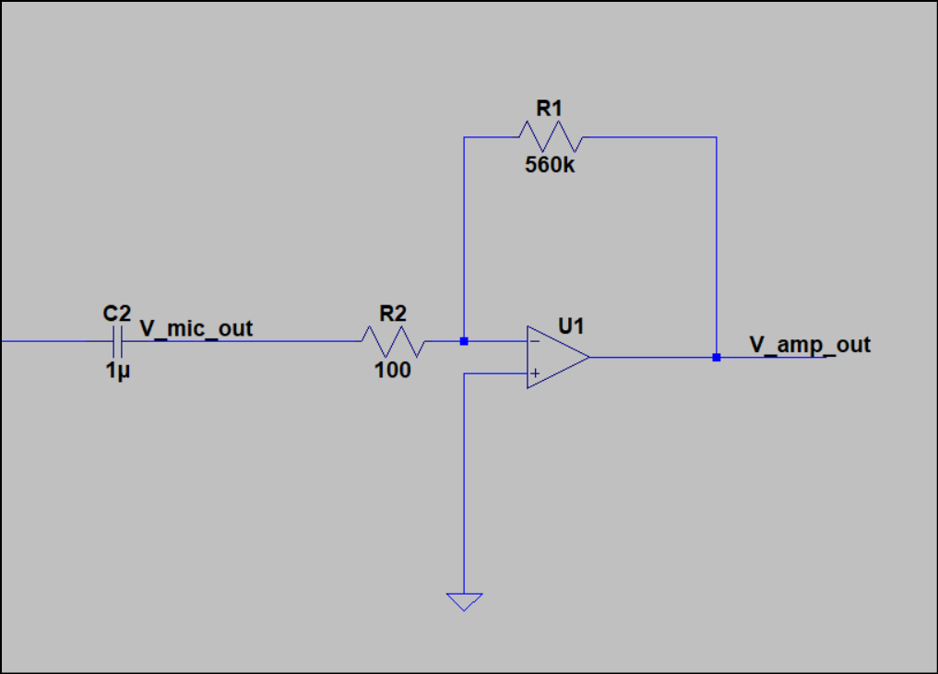
Amplifier Circuit from LTspice

Slide 7
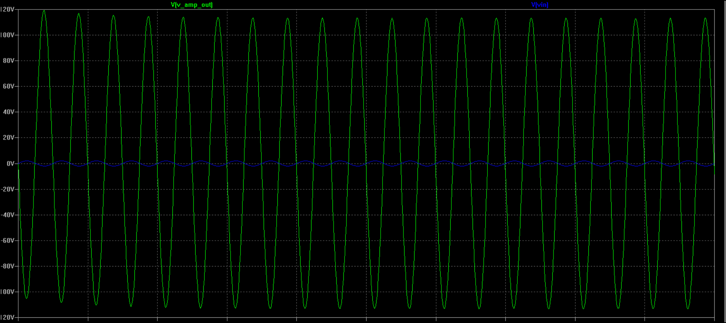
The graph of the amplifier circuit from LTspice

Slide 8
Heart Filter
The parts of it:
* Four capacitors
* Four resistors
* -12 V
* +12 V
*Ground
* Two LM-358 op-amp

Slide 9
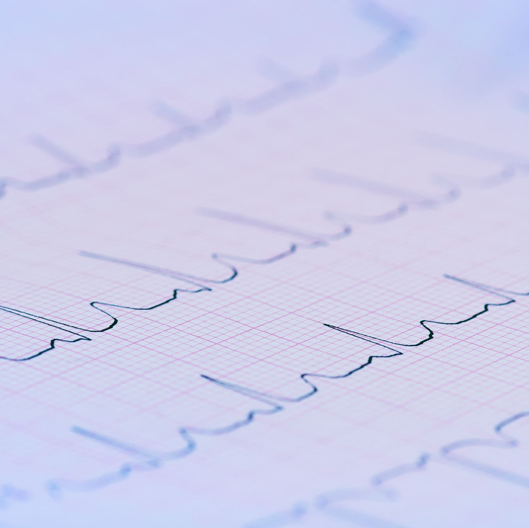
About heart filter
* Sallen-Key Band Pass Filter
* It is buffer type of filter, «connection type»
* Second order band pass filter
* The frequency range between 23.405Hz - 234.05 Hz
* Bandwith nearly 210 Hz
* The center frequency 74.0131 Hz
* Q(quality factor) 0.35244

Slide 10
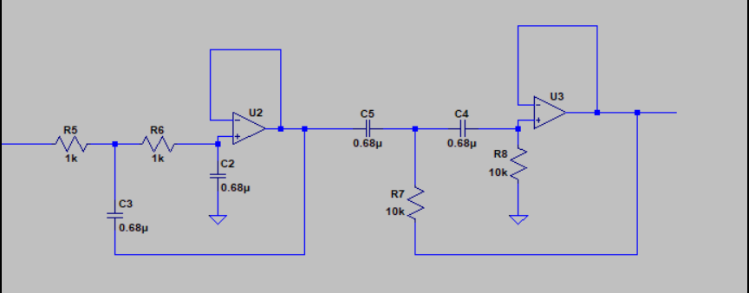
Heart Filter from LTspice

Slide 11
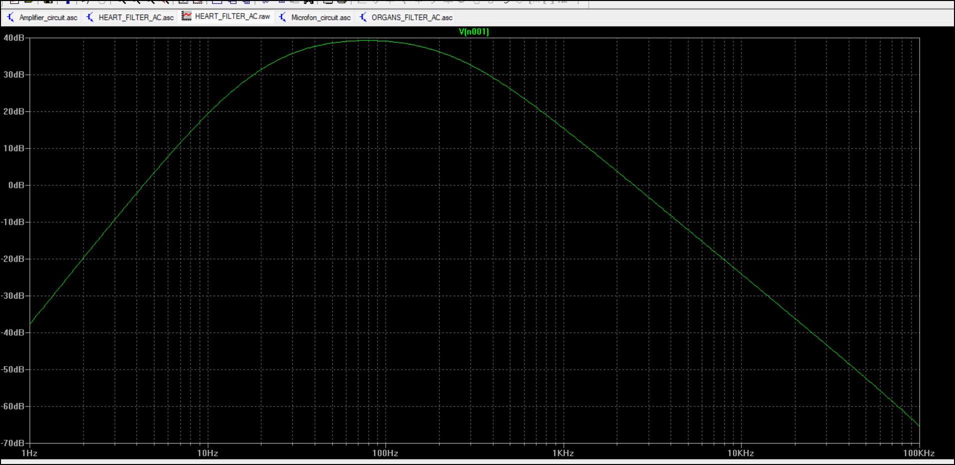
The graph of the heart filter from LTspice

Slide 12
Organs Filter
The parts of it:
* Four capacitors
* Four resistors
* -12 V
* +12 V
*Ground
* Two LM-358 op-amp

Slide 13

About organs signal
* Sallen-Key Band Pass Filter
* It is buffer type of filter, «connection type»
* Second order band pass filter
* The frequency range between 72.243 – 1061.032 Hz
* Bandwith nearly 999 Hz
* The center frequency 277.0527 Hz
* Q(quality factor) 0.277

Slide 14
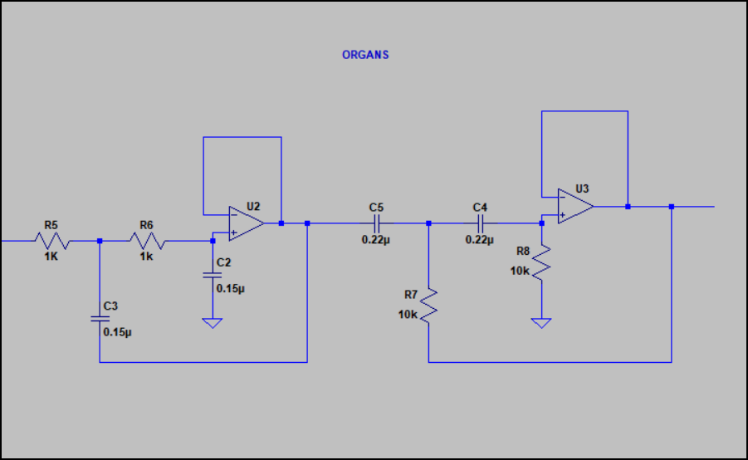
Organs Filter from LTspice

Slide 15
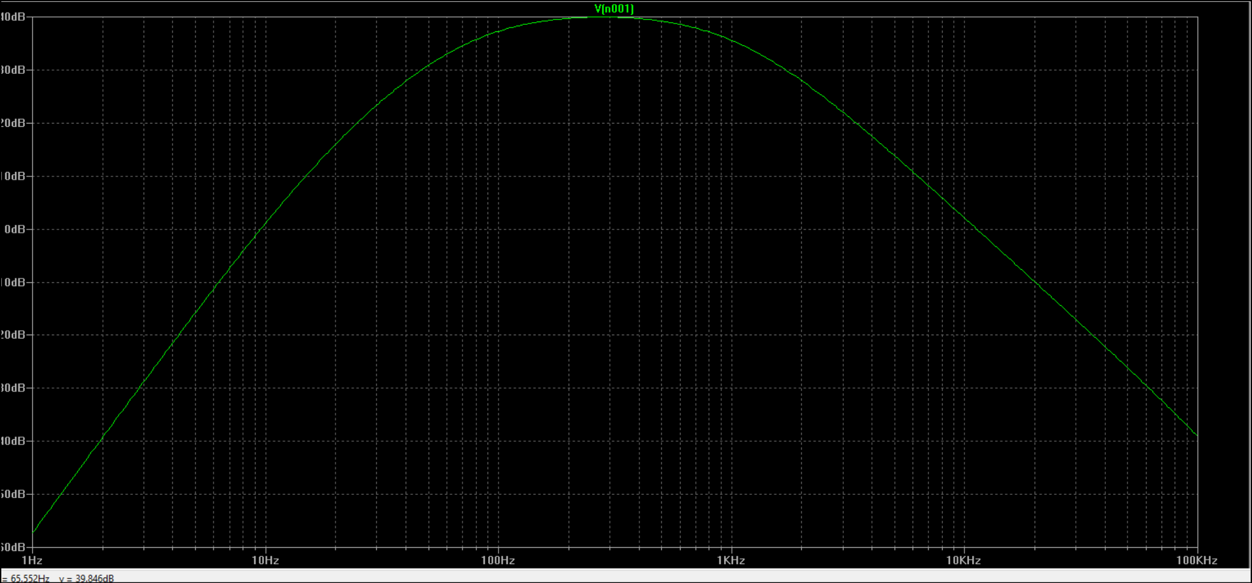
The graph of the organs filter from LTspice

Slide 16
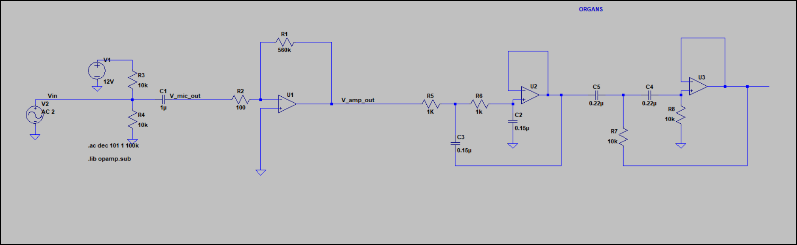
The whole organs circuit

Slide 17
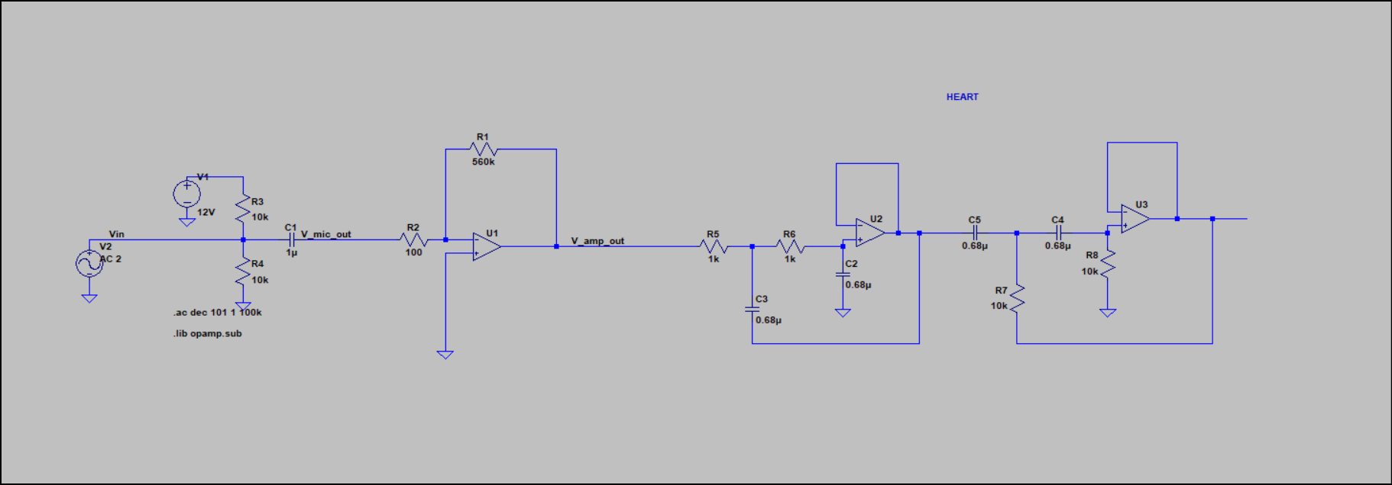
The whole heart circuit

Slide 18
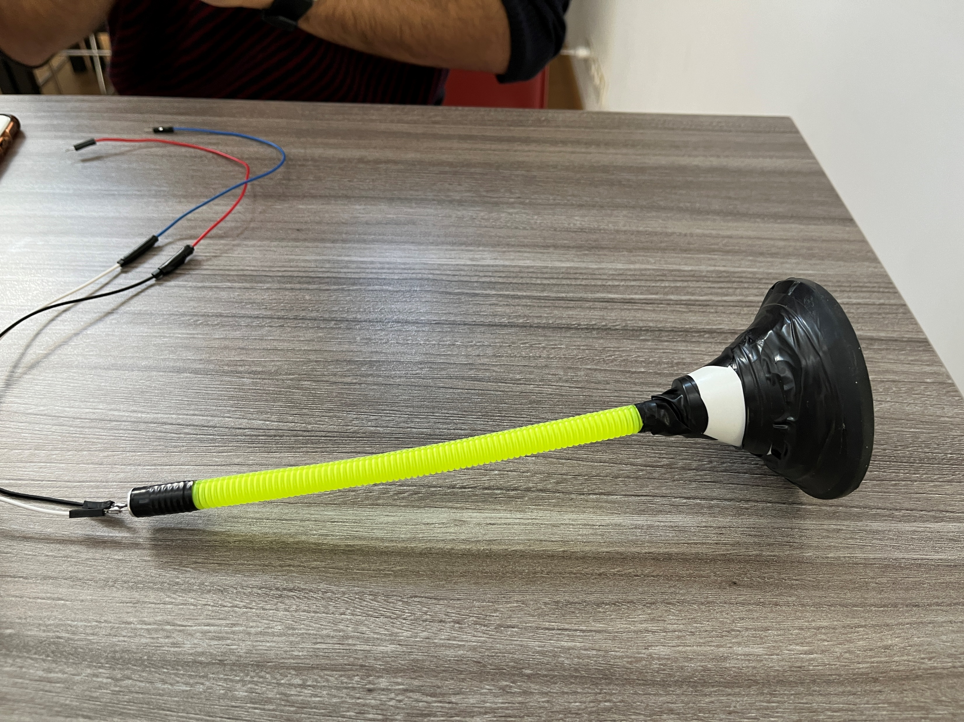
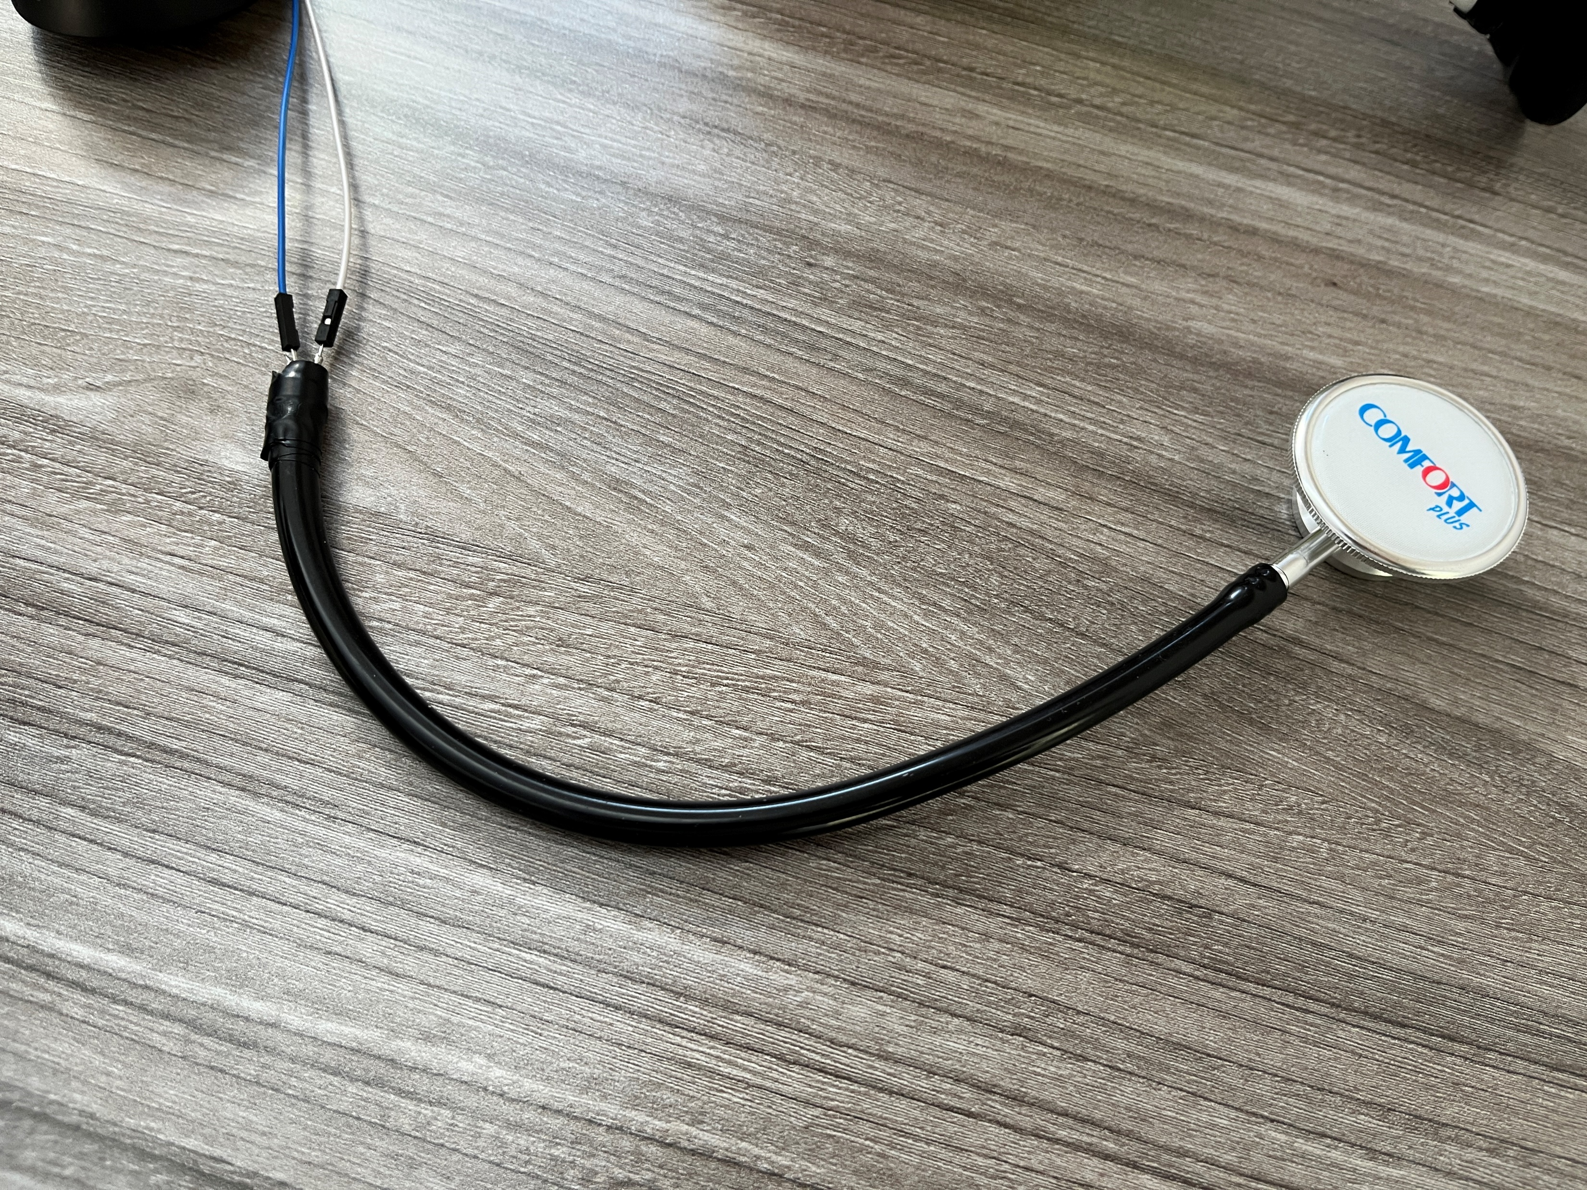
Home-made VS Fabrication

Slide 19

Thank you for your time ☺

